Slide 1
Analysis of Glassdoor Reviews for competitors - FactSet

Slide 2
Agenda
Executive Summary
Overall word cloud for Pros and Cons
What people liked (based on 5 star ratings)
What people liked (based on 4 star ratings)
What people liked (based on 3 star ratings)

Slide 3
Executive Summary
Objectives
Scrapping Glassdoor reviews for competitors given by their employees.
Analyzing reviews of competitors
Identify hidden patterns in data about employee engagement.
Key Observations
We scrapped close to 90% of reviews.
Total 1400 reviews were analyzed.

Slide 4
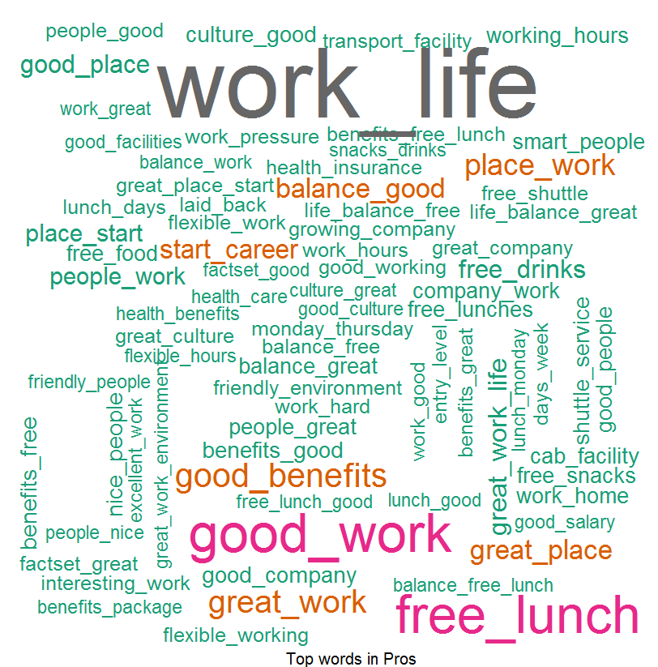
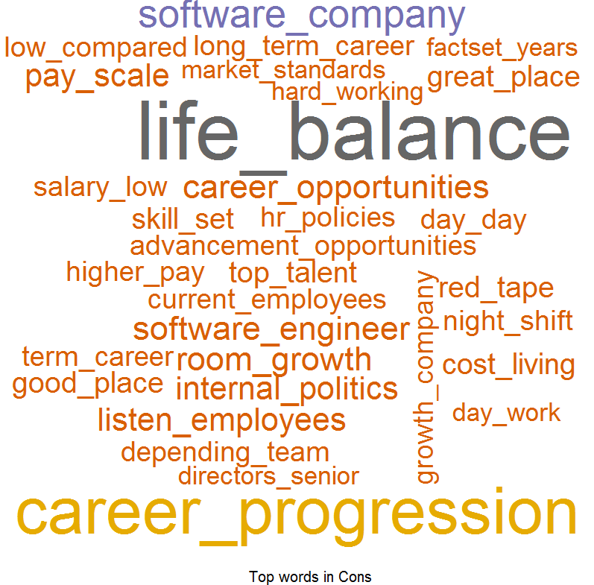
Overall Word Cloud for Pros and Cons
Word Cloud for Pros
Word Cloud for Cons
Good Words List –
Work life balance
Good work
Free lunch
Work environment
Great benefits
Work Culture
Word List which people don’t like –
Career growth
Work life balance
Upper management
Career progression
Low pay
Not good work
Senior management
High turnover

Slide 5
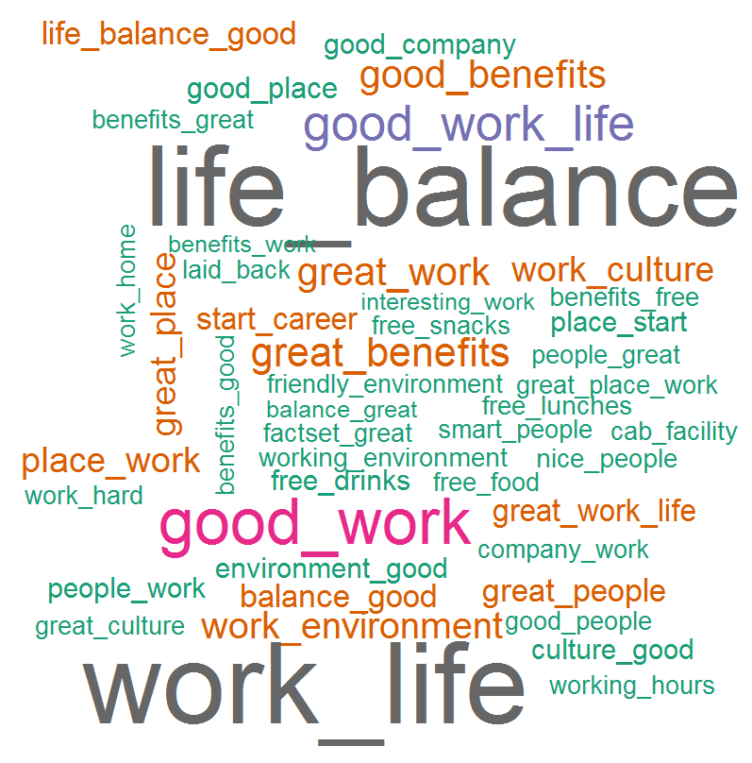
What people liked (based on 4 star ratings)
Word Cloud for Pros
Good Words List –
Work life balance
Good work
Free Lunch
Great Benefits
Great Work
Work environment
Work culture
Great people
Good place to start
Free drinks
Free food
Cab facility
Work from home
Friendly environment

Slide 6
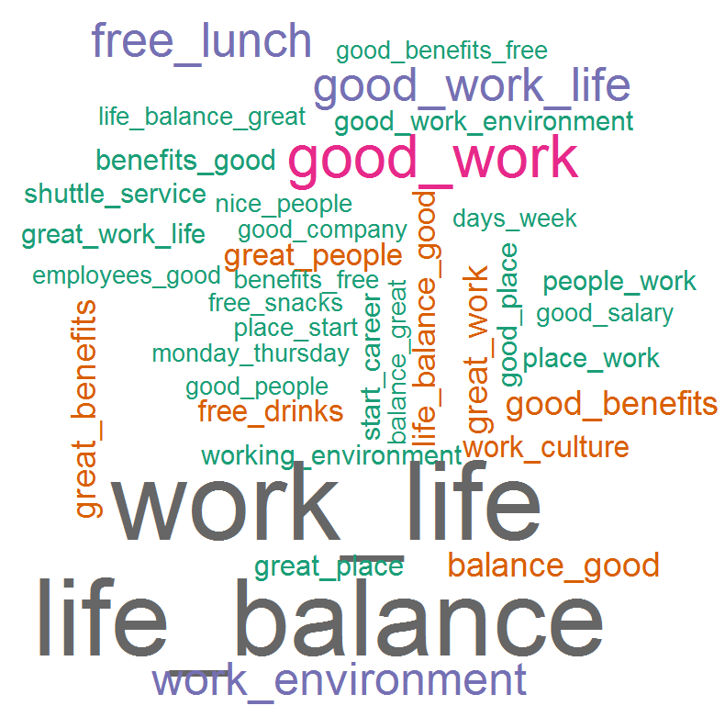
What people liked (based on 3 star ratings)
Word Cloud for Pros
Good Words List –
Work life balance
Good work
Free Lunch
Good work environment
Good benefits
Great people
Work culture
Free drinks
Good place to start career
Shuttle service
Good salary
Nice people

